Slide 1
Data-Driven Bank Fraud Analytics And Risk Monitoring Using Transaction And Customer Behaviour Analysis at Quest Innovative Solutions Pvt Ltd, Kochi
BY
ABHISHA JL
Guide: Mrs. Rohini

Slide 2
1
Banking transactions have increased significantly with the growth of digital banking and online payments.
2
The increasing volume of transactions also creates opportunities for fraudulent activities.
INTRODUCTION
3
Fraudulent transactions can cause financial losses, customer dissatisfaction, and reputational damage to banks.
4
Analyzing transactional and customer-related patterns can help identify unusual and potentially risky transactions.
5
This project applies data analytics techniques to analyze transaction behavior and develop a rule-based risk scoring approach for fraud monitoring.

Slide 3
Banking and Financial Services is a major data-driven industry that
generates large volumes of transactional and customer data.
Data Analytics helps organizations convert this data into meaningful
insights for better decision-making.
Fraud Analytics is used to identify unusual transaction patterns and
potentially fraudulent activities.
Key areas include transaction analysis, risk monitoring, data visualization,
and predictive decision support.
The growth of digital banking and online payments has increased the
need for data-driven fraud detection and risk management solutions.
INDUSTRY PROFILE
Data Analytics & Banking

Slide 4
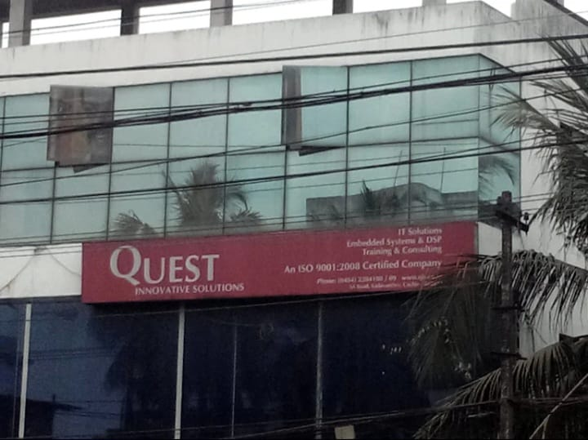

COMPANYPROFILE
Quest Innovative Solutions Pvt Ltd,
Thiruvananthapuram
VISION
“To achieve excellence in software development and technology services through quality, innovation, continuous improvement, and customer satisfaction.”
Courses Offered
Data Analytics, Data Science, AI, Full-Stack Development, and Embedded Systems.
Branches
1. Quest Innovative Solutions Pvt Ltd, Panavilai, Thiruvananthapuram
2. Quest Innovative Solutions Pvt Ltd,
Kozhicode, Calicut
3. Quest Innovative Solutions Pvt Ltd,
Kannur
MISSION
“To provide effective and business-focused software solutions, research and development, consultancy, and training services using advanced technology and skilled professionals.”
Company Logo

Slide 5
The increasing volume of digital banking transactions makes it difficult for banks to manually identify fraudulent activities.
Fraudulent transactions may occur across different transaction, customer, device, merchant, and time-related patterns, making them challenging to monitor effectively.
Therefore, there is a need for a data-driven approach to analyze transaction behavior, identify fraud-related patterns, assess transaction risk, and support effective fraud monitoring.
PROBLEM STATEMENT

Slide 6
Helps identify patterns associated with fraudulent transactions.
Supports better understanding of high-risk transaction characteristics.
Helps banks improve fraud monitoring and risk assessment.
Provides data-driven insights for decision-making.
Interactive dashboards enable easy monitoring and visualization of fraud patterns.
NEED OF THE STUDY

Slide 7
OBJECTIVES
1.To analyze customer and transaction behaviour using banking transaction data.
2.To identify patterns associated with fraudulent transactions.
3.To compare fraudulent and genuine transactions based on transaction amount, account balance, transaction type, device type, time, and other characteristics.
4.To calculate fraud rates across different transaction and customer-related categories.
5.To engineer analytical features such as transaction size, age group, time of day, balance utilization, and risk level.
6.To develop a rule-based heuristic risk scoring system for transaction risk monitoring.
7.To analyze fraud patterns using SQL queries and analytical views.
8.To develop an interactive Tableau dashboard for monitoring fraud trends and risk patterns.
9.To generate meaningful insights that can support banking fraud-monitoring decisions.
10.To provide recommendations for improving fraud monitoring and future analytical capabilities.

Slide 8
Focuses on banking transaction data containing 200,000 transactions.
Analyzes fraudulent and genuine transactions.
Examines transaction patterns across:
Transaction & merchant characteristics
Customer demographics
Device & location
Time-related factors
Includes feature engineering and rule-based risk scoring.
Uses data visualization and interactive dashboards to support fraud monitoring.
SCOPE OF THE STUDY

Slide 9
DATASET &
VARIABLES
Dataset Overview
Dataset: Banking Transaction Dataset
Total Transactions: 200,000
Total Variables: 24
Fraudulent Transactions: 10,088
Genuine Transactions: 189,912
Fraud Rate: 5.04%
TOTAL TRANSACTIONS
200K
TOTAL VARIABLES
24
Major Variables
Customer: Customer ID, Gender, Age, State, City, Account Type
Transaction: Transaction ID, Date, Time, Amount, Type, Currency
Merchant & Device: Merchant Category, Merchant ID, Device Type, Transaction Device, Location
Fraud & Risk: Is_Fraud, Account Balance, Balance Utilization, Risk Score, Risk Level
FRAUDULENT TRANSACTION
10088
FRAUD RATE
5.04%

Slide 10
TOOLS & TECHNOLOGIES USED
Data Preparation
Data Visualization
Microsoft Excel
Python – Pandas, NumPy
Power BI
Tableau
Matplotlib
Data Analysis
Development
Python
SQL / MySQL
MongoDB
VS Code

Slide 11
CLEANING PROCESS
VALIDATION RESULTS
Raw Data
Dataset Overview
Missing Values : 0
Duplicate Rows : 0
Invalid Age : 0
Invalid Transaction Amount : 0
Invalid Account Balance : 0
Invalid Is_Fraud Values : 0
Invalid Currency : 0
Data Quality Checks
DATA CLEANING AND PRE PROCESSING
Validation
Clean Dataset
Analysis

Slide 12
EXPLORATORY DATA ANALYSIS (EDA)
Analyzed the overall fraud vs. genuine transaction distribution.
Examined fraud patterns across gender, age group, account type, and state.
Analyzed fraud rates by transaction type and merchant category.
Studied fraud patterns across devices, locations, day of week, and time of day.
Compared transaction amounts and account balances between fraud and genuine transactions.
Used statistical summaries and visualizations to identify important patterns.

Slide 13
FEATURE ENGINEERING
Hour – Extracted from transaction time
Age Group – Categorized customers by age
Day Name – Derived from transaction date
Month Name – Derived from transaction date
Transaction Size – Categorized by transaction amount
Balance Category – Categorized by account balance
Time of Day – Classified into Late Night, Morning, Afternoon, and Evening
Balance Utilization – Calculated as Transaction Amount ÷ Account Balance
Risk Score & Risk Level – Created using predefined business rules

Slide 14
RULE-BASED RISK SCORING METHODOLOGY
Risk Scoring Approach
Risk Factor | Score
Very High Transaction Size | +30
High Transaction Size | +20
Late Night Transaction | +20
Very High Account Balance | +15
Balance Utilization > 2 | +35
Risk Level Classification
Risk Level | Score Range
Low Risk | ≤ 20
Medium Risk | 21–50
High Risk | > 50
The Risk Score is a manually defined heuristic and is not an ML-generated score.

Slide 15
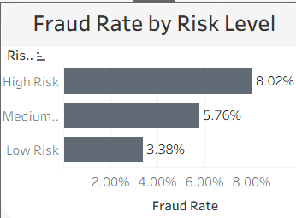
RISK LEVEL ANALYSIS
Risk Level Distribution
Risk Level | Transactions | Fraud Transactions | Fraud Rate
Low Risk | 101,589 | 3,435 | 3.38%
Medium Risk | 54,676 | 3,147 | 5.76%
High Risk | 43,735 | 3,506 | 8.02%

Slide 16
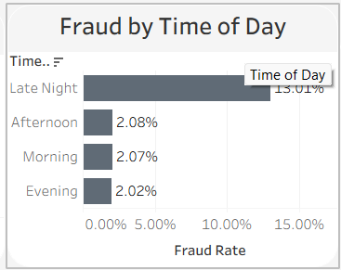
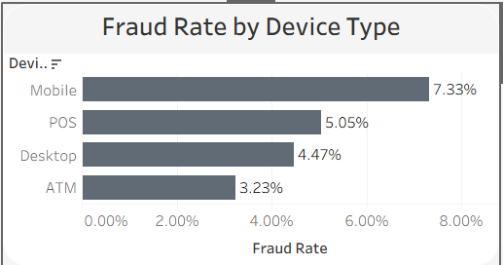
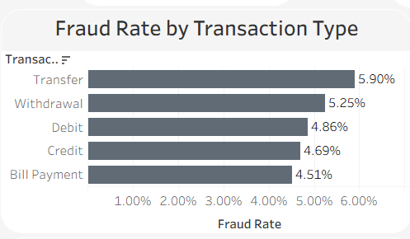
KEY EDA FINDINGS
Electronics recorded the highest fraud rate at approximately 6.05% among merchant categories.
High-risk transactions recorded the highest observed fraud rate of 8.02%.
Fraud patterns varied across transaction types, devices, merchant categories, and customer segments.
Fraudulent and genuine transactions showed differences in transaction amount and balance utilization.
Time-related factors such as time of day and day of week showed variations in fraudulent transaction patterns.
Geographical and account-related factors also showed differences in fraud occurrence.

Slide 17
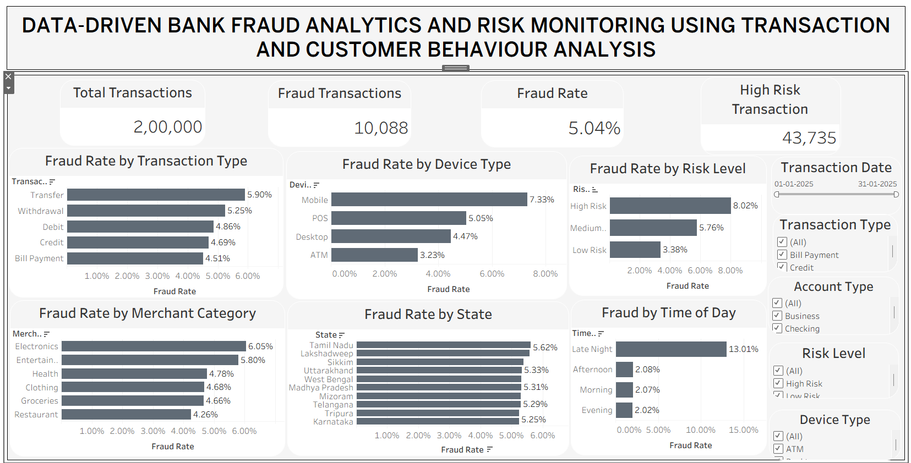
INTERACTIVE DASHBOARD

Slide 18
KEY INSIGHTS
5.04% of the 200,000 transactions were identified as fraudulent.
Late-night transactions recorded the highest fraud rate at 13.01%.
Mobile devices recorded the highest device-wise fraud rate at 7.33%.
Transfer transactions had the highest fraud rate among transaction types at 5.90%.
High-risk transactions showed the highest observed fraud rate at 8.02%.
Fraud patterns varied across merchant categories, states, account types, and customer groups.

Slide 19
BUSINESS RECOMMENDATIONS
5.04% of the 200,000 transactions were identified as fraudulent.
Late-night transactions recorded the highest fraud rate at 13.01%.
Mobile devices recorded the highest device-wise fraud rate at 7.33%.
Transfer transactions had the highest fraud rate among transaction types at 5.90%.
High-risk transactions showed the highest observed fraud rate at 8.02%.
Fraud patterns varied across merchant categories, states, account types, and customer groups.

Slide 20
LIMITATIONS OF THE STUDY
The study is based on a single banking transaction dataset.
The dataset does not provide long-term transaction history for individual customers.
The risk score is a rule-based heuristic, not a machine learning model.
The analysis is based on historical/static data, so it does not represent real-time fraud detection.
The identified patterns may not represent all banking environments or customer populations.

Slide 21
FUTURE SCOPE
Develop real-time fraud detection systems for continuous transaction monitoring.
Apply Machine Learning models to improve fraud prediction and classification.
Incorporate customer behavioral profiling using historical transaction patterns.
Use advanced techniques such as anomaly detection to identify previously unknown fraud patterns.
Integrate additional data sources such as device behavior, location, and transaction history.
Develop automated fraud alerts and risk-based intervention systems.

Slide 22
Conclusion
The study analyzed 200,000 banking transactions to identify fraud-related patterns.
Fraudulent transactions accounted for 5.04% of the dataset.
Time, device, transaction type, and risk-related factors showed meaningful differences in fraud rates.
The rule-based risk scoring approach helped categorize transactions into Low, Medium, and High Risk.
Interactive dashboards provided an effective way to monitor and analyze fraud patterns.
The study demonstrates how data analytics can support bank fraud monitoring and decision-making.

Slide 23
THANK YOU

